Slide 1
Socket Programming (MP-1)
Modified by Subhajit Gorai, 2023/9/01

Slide 2
Socket programming
Goal: learn how to build client/server application that communicate using sockets
socket
Socket API
introduced in BSD4.1 UNIX, 1981
explicitly created, used, released by apps
client/server paradigm
two types of transport service via socket API:
unreliable datagram
reliable, byte stream-oriented
a host-local,
application-created,
OS-controlled interface (a “door”) into which
application process can both send and
receive messages to/from another application process
2: Application Layer
2
Notes:
2
We will mostly talk about socket programming for TCP but for UDP – this doesn’t change much.
Before getting into coding, discussing basics of socket programming
What’s a socket – from a computing point of view – an interface that allows you to send and receive messages from another application/process – the other application or process can be running on the same or different machine/host
Socket API – allows you to control this interface or socket

Slide 3
Socket-programming using TCP
Socket: a door between application process and end-end-transport protocol (UDP or TCP)
TCP service: reliable transfer of bytes from one process to another
controlled by
application
developer
controlled by
application
developer
process
process
socket
socket
TCP with
buffers,
variables
TCP with
buffers,
variables
controlled by
operating
system
controlled by
operating
system
internet
host or
server
host or
server
2: Application Layer
3
Notes:
3
- Its like a door b/w a n/w application that you may be developing & the underlying transport protocols. As an application developer, all you want to care about is defining how you want to receive the messages and leave the rest to the OS to arrange. So sockets and the socket API help you do that

Slide 4
Socket programming: Terminology
Term | Format | Example | Analogy-phone
IP(v4) | x.x.x.x | 192.168.0.1 | Phone number
Port | N<65535 | 80 | Extension #
Socket | [memory/ resource] | s=socket(…) | Physical phone
Notes:
4
Some basic things associated with a socket:
IPv4 or IPv6 address
Port – to allow multiple application to be running (on a client side you could be running multiple browses and each associated with a different port, similarly a web server can have different ports to cater to different clients or offer different service)
Socket/socket descriptor – This essentially means that you have resources allocated for a socket/connection

Slide 5
Socket programming with TCP
Client must contact server
server process must first be running
server must have created socket (door) that welcomes client’s contact
Client contacts server by:
creating client-local TCP socket
specifying IP address, port number of server process
When client creates socket: client TCP establishes connection to server TCP
When contacted by client, server TCP creates new socket for server process to communicate with client
allows server to talk with multiple clients
source port numbers used to distinguish clients
application viewpoint
TCP provides reliable, in-order
transfer of bytes (“pipe”)
between client and server
2: Application Layer
5
Notes:
5
Source port number for clients is automatically assigned by OS. TCP server uses the source port address to distinguish between different clients

Slide 6
Client/server socket interaction: TCP
Server (stand-by, waiting for requests)
Client (initiate the request)
Create socket
(Claim resources/ available phone)
Create socket
(Claim resources/ available phone)
Bind port
(Claim ID on this machine/
get a phone extension No.)
-
(Don’t care about public port/ phone #)
Listen & accept
(Listen: Wait for connections/ Wait for phone call
Accept: Accept connection/ Answer phone call )
Connect
(connect to server/ call others)
Send/ receive
(Communication/ Chat on phone)
Send/ receive
(Communication/ Chat on phone)
Close socket
(End communication/ Hang up the phone)
Close socket
(End communication/ Hang up the phone)
Red word: wait for the other side
Notes:
6

Slide 7
Client/server socket interaction: TCP
Server (stand-by, waiting for requests)
Client (initiate the request)
1
4
Create socket
(Claim resources/ available phone)
Create socket
(Claim resources/ available phone)
2
Bind port
(Claim ID on this machine/
get a phone extension No.)
-
(Don’t care about public port/ phone #)
3
5
Listen & accept
(Listen: Wait for connections/ Wait for phone call
Accept: Accept connection/ Answer phone call )
Connect
(connect to server/ call others)
Send/ receive
(Communication/ Chat on phone)
6
6
Send/ receive
(Communication/ Chat on phone)
7/8
7/8
Close socket
(End communication/ Hang up the phone)
Close socket
(End communication/ Hang up the phone)
Red word: wait for the other side
Notes:
7

Slide 8
Client/server socket interaction: TCP
Server (stand-by, waiting for requests)
Client (initiate the request)
Create socket
(Claim resources/ available phone)
Create socket
(Claim resources/ available phone)
Bind port
(Claim ID on this machine/
get a phone extension No.)
Listen/ accept
Connect
(connect to server/ call others)
Fork/ New thread
Parent
Child
Send/ receive
(Communication/ Chat on phone)
Send/ receive
(Communication/ Chat on phone)
Close socket
(End communication/ Hang up the phone)
Close socket
(End communication/ Hang up the phone)
Notes:
8

Slide 9
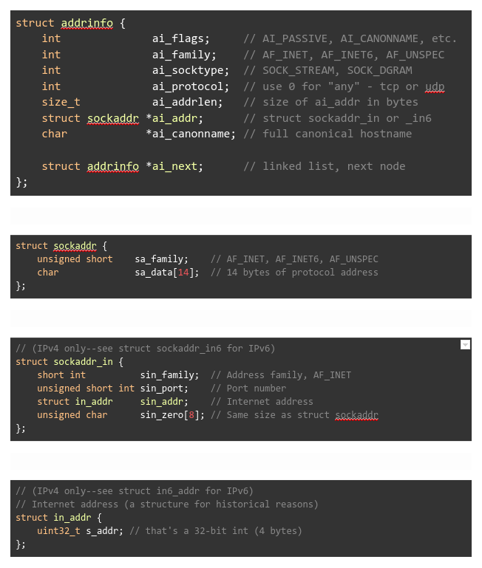
Structs
https://beej.us/guide/bgnet/html/split-wide/index.html

Slide 10
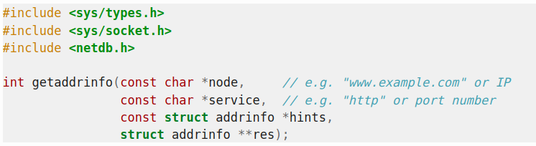
System Calls - I
node : hostname or IP as string service : protocol name or port number as string hints : struct addrinfo that you’ve already filled out with relevant information
res : returned addrinfo (note the type, i.e. struct addrinfo ** )
https://beej.us/guide/bgnet/html/split-wide/index.html
Notes:
10

Slide 11
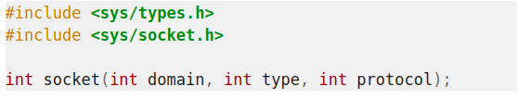
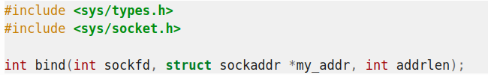
System Calls - II
domain: PF_INET or PF_INET6(IPv4 or IPv6)
type: SOCK_STREAM or SOCK_DGRAM (TCP or UDP) protocol: can be set to 0 to choose the proper protocol for the given type("tcp" or "udp")
sockfd: socket file descriptor returned by socket()
my_addr : a pointer to a struct sockaddr that contains information about your address, namely, port and IP address
addrlen : size of my_addr
https://beej.us/guide/bgnet/html/split-wide/index.html
Notes:
11

Slide 12
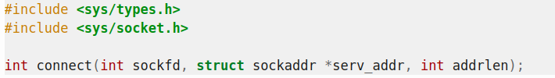

System Calls- III
sockfd: socket file descriptor returned by socket()
serv_addr: a struct sockaddr containing the destination port and IP address
addrlen : size of serv_addr
sockfd: socket file descriptor returned by socket()
backlog : number of connections allowed on the incoming queue
sockfd: socket file descriptor returned by socket()
addr : a pointer to a struct sockaddr, information about the incoming connection(a pointer to a local struct sockaddr_storage)
addrlen : should be set to sizeof(struct sockaddr_storage)
https://beej.us/guide/bgnet/html/split-wide/index.html
Notes:
12

Slide 13
System Calls- IV
sockfd: socket file descriptor returned by socket()
msg : a pointer to the data you want to send
len : length of the data in bytes flags : default to 0 // returns actual bytes send
sockfd: socket file descriptor returned by socket()
buf: buffer to read the information into len : maximum length of the buffer //returns actual bytes read
UPD variants
https://beej.us/guide/bgnet/html/split-wide/index.html
Notes:
13

Slide 14
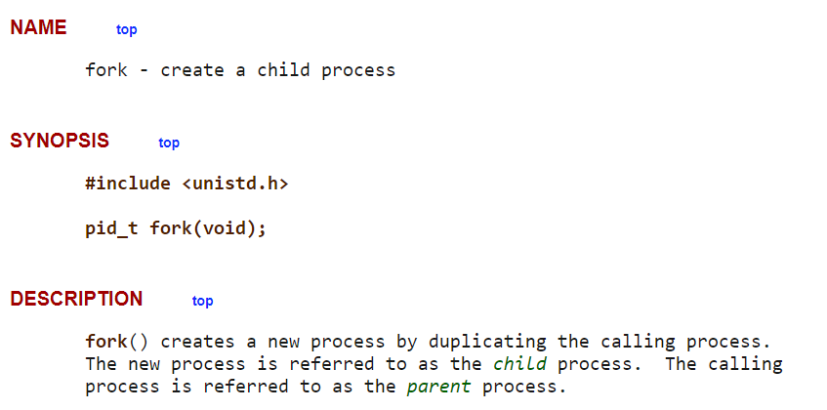
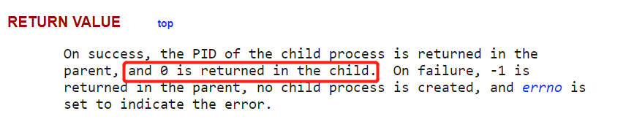
Linux Process Creation: fork()
https://man7.org/linux/man-pages/man2/fork.2.html
Notes:
14

Slide 15
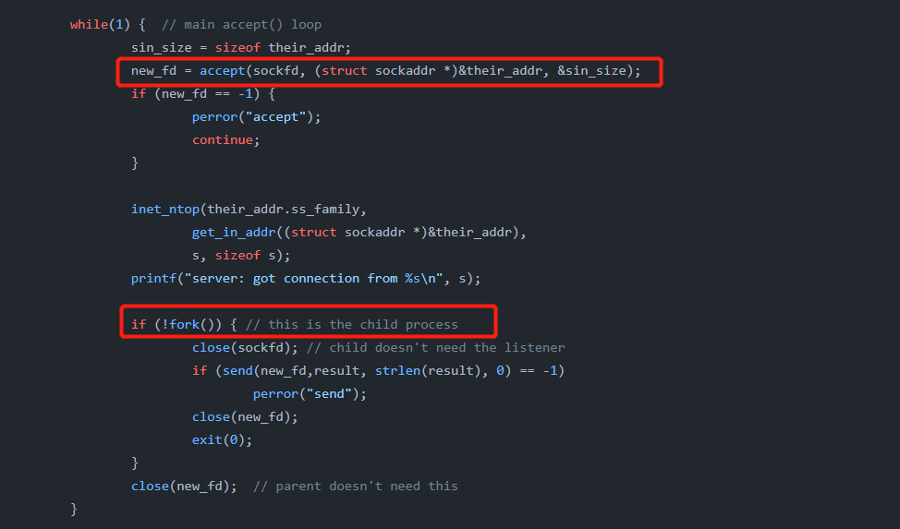
Client/server socket interaction: TCP
What happens when a new connection comes in?
Notes:
15

Slide 16
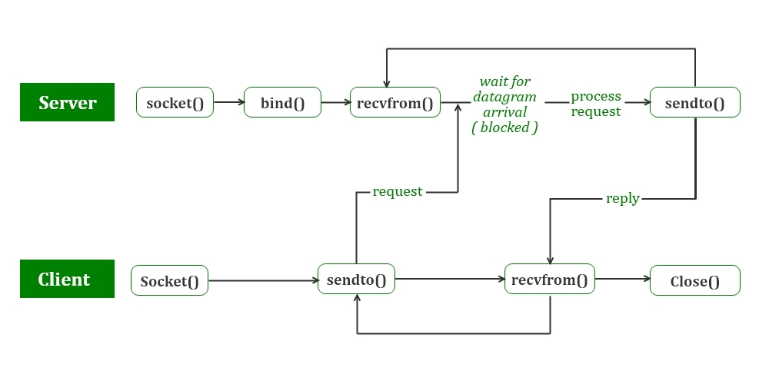
Socket programming with UDP
You won’t need UDP for MP1, but you will need it for MP2.
https://www.geeksforgeeks.org/udp-server-client-implementation-c/
2: Application Layer
16
Notes:
16
Source port number for clients is automatically assigned by OS. TCP server uses the source port address to distinguish between different clients

Slide 17
Client/server socket interaction: UDP Only a brief introduction
No connect(), listen(), accept(), basically there is no connection for a UDP.
So no need to spawn a new thread for every accept(), because accept() is only for TCP.
Use sendto() and recvfrom(). Since we don’t need connection in UDP, when you want to send, you have to specify where to send, very natural idea.
UDP is like throwing any data to your mailbox, and don’t care if I can throw it in or if you will open the mailbox and check in the future.
Notes:
17

